Slide 1


Generative AI for Researchers
Motaz Saad

Slide 2
About me
Motaz Saad, computer Scientist.
PhD in CS from Univ Lorraine, France.
Working in Academia in many universities in Palestine.
Collaborated with Many universities in Europe
Working in industry as a consultant.

Slide 3

Copyright Notice
These slides are distributed for educational purpose under the Creative Commons License. https://creativecommons.org/licenses/by-sa/2.0/legalcode
Source of Slides:
DeepLearning.AI as the source of the slides.
Generative AI :)
Harvard Teaching and Learning Consortium

Slide 4
In this course ...
Intro to Gen AI
intro to Large Language Models LLMs
Prompt Engineering
AI tools for researchers
Responsible AI

Slide 5
After this course, you should be able to:
Understand the principles and applications of generative AI.
Explain how large language models work.
Utilize prompt engineering techniques to elicit desired outputs from AI models across various tasks, including data generation, summarization, and idea development, ... etc.
Utilize AI tools to support and enhance academic research activities.
Identify and implement responsible AI practices in research.

Slide 6
Introduction to Gen AI
A gentle intro :)

Slide 7

What is AI?
Human intelligence (HI): ability to learn, think, solve problems, ....
Artificial Intelligence (AI): enable computer to learn, think and solve problems.

Slide 8
AI is already pervasive in our lives
Area | Examples | Description
Web Search Engines | Google, Yahoo | Use AI to improve search algorithms, provide relevant search results, and offer personalized search suggestions.
Social Media | Facebook, Instagram, X | Use AI to curate news feeds, detect inappropriate content, and provide targeted advertisements based on user behavior and preferences.
Transportation | Uber, Lyft | Use AI for navigation, and optimizing routes to improve efficiency and safety in transportation.

Slide 9
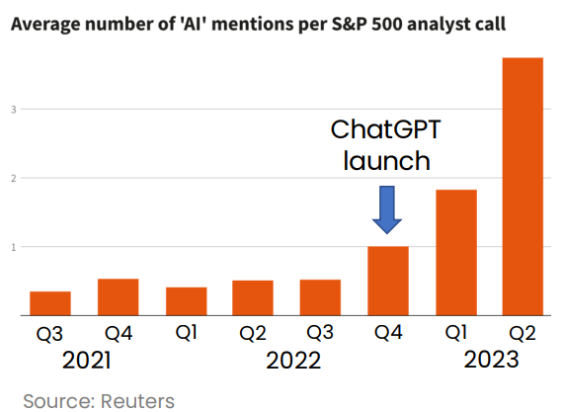
The rise of generative AI
Impact 10% of the tasks carried out daily by 80% of workers
source: OpenAI/UPenn

Slide 10
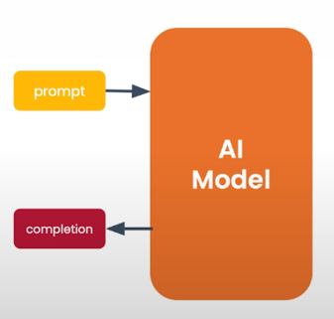
What is generative AI?
Gen AI is an Artificial intelligence systems that can produce high quality content, specifically text, images, and audio.

Slide 11
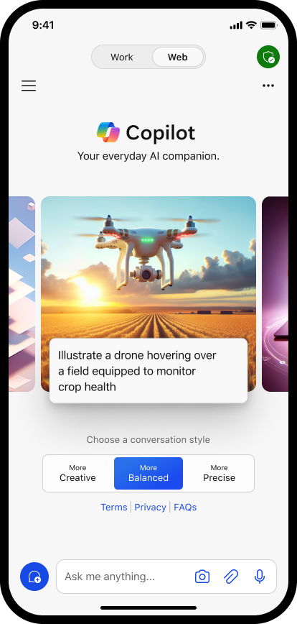
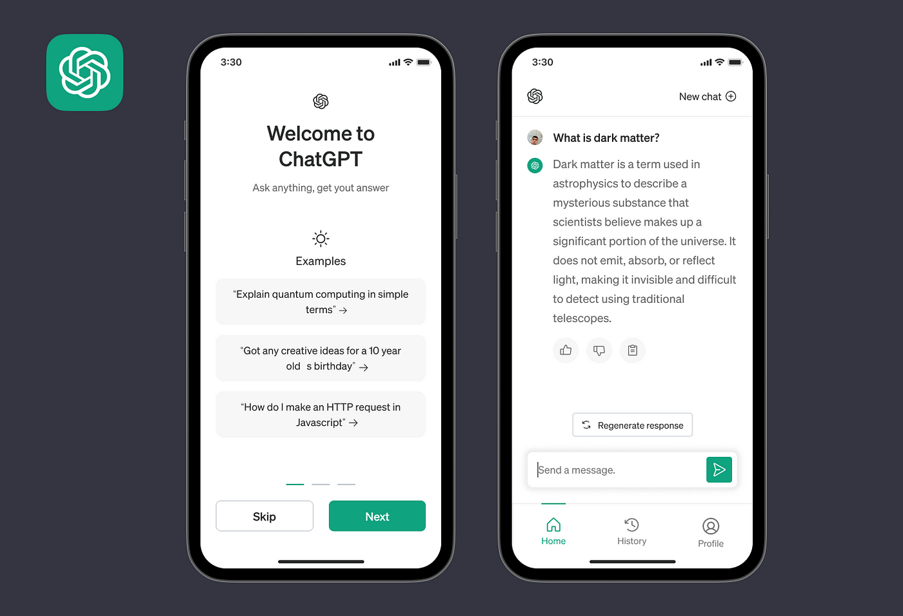
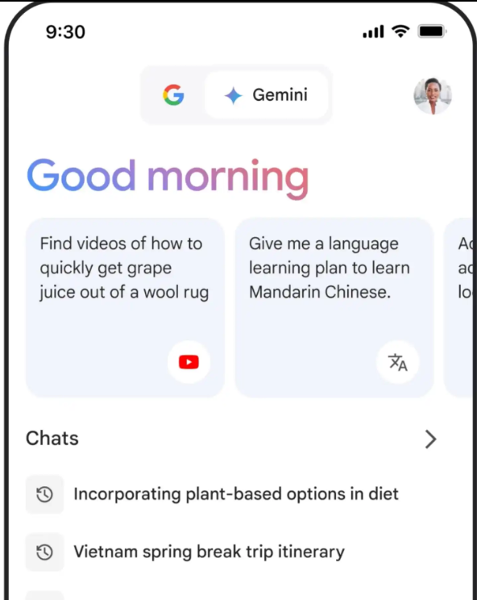


Gen AI Tools for end users (mobile App)

Slide 12
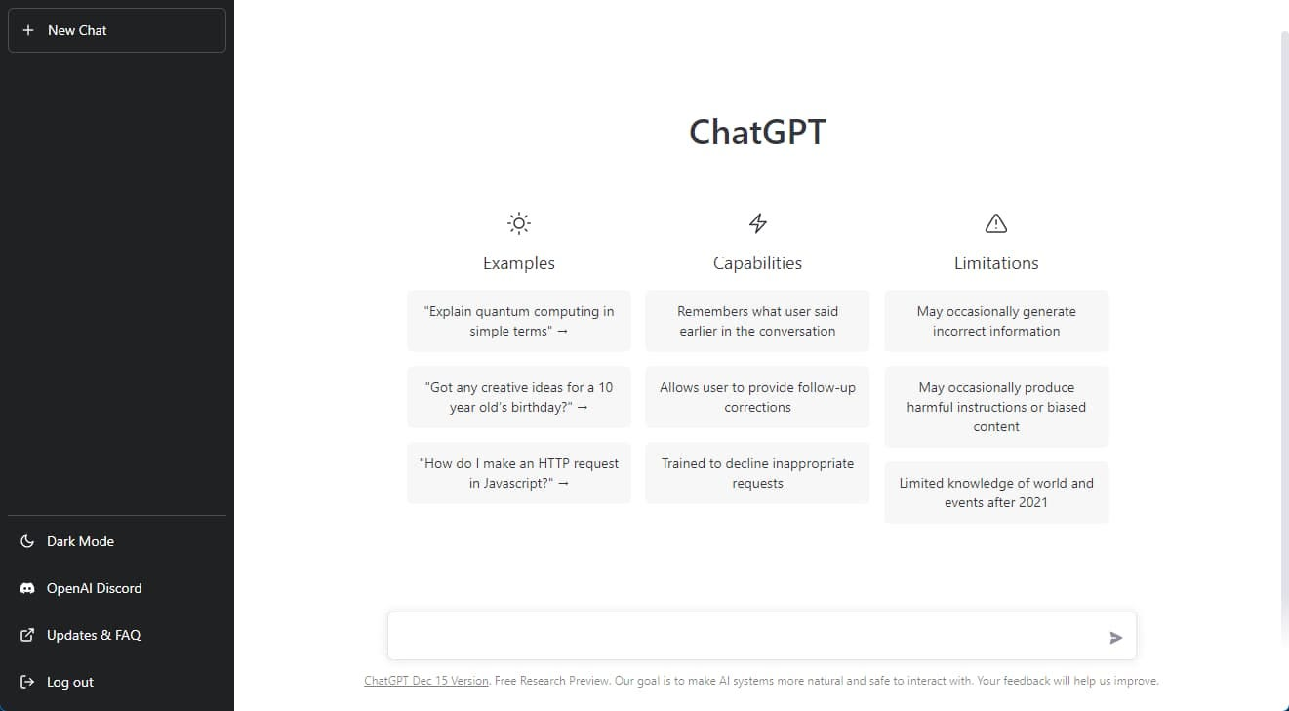
Gen AI Tools for end users (ChatGPT Web App)

Slide 13
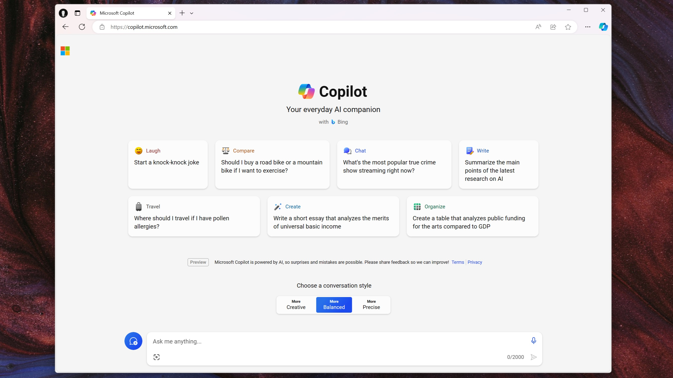
Gen AI Tools for end users (Copilot Web App)

Slide 14
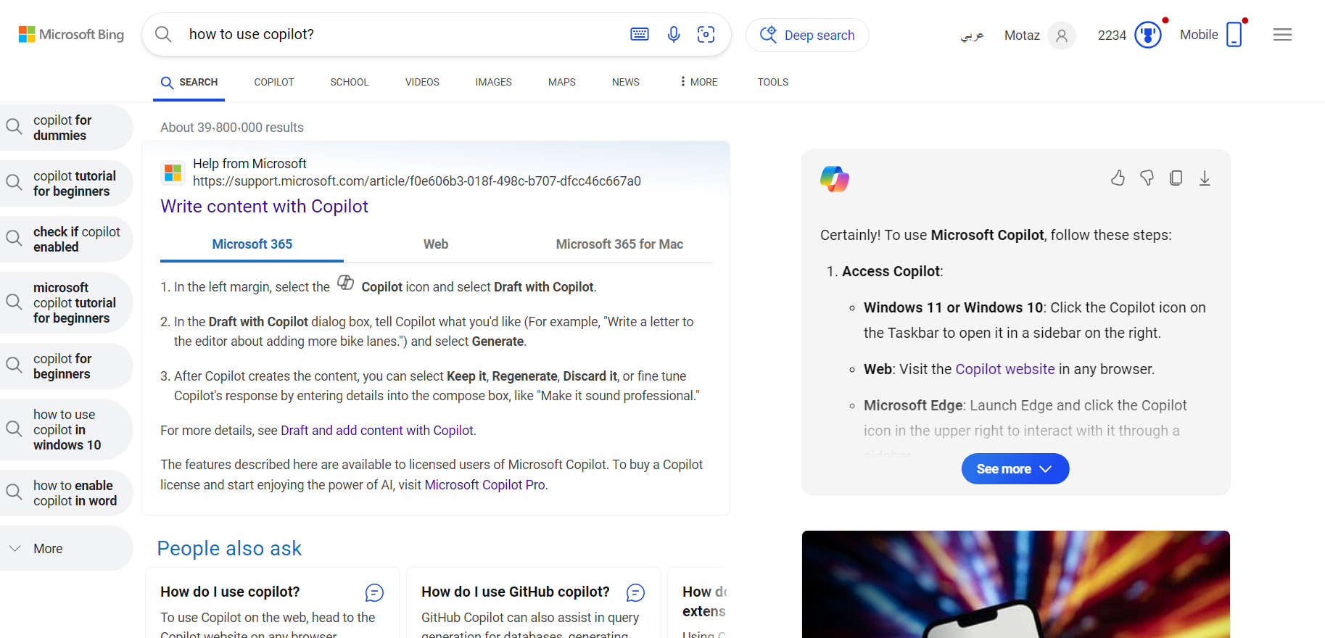
Gen AI Tools for end users (Copilot Web App)

Slide 15
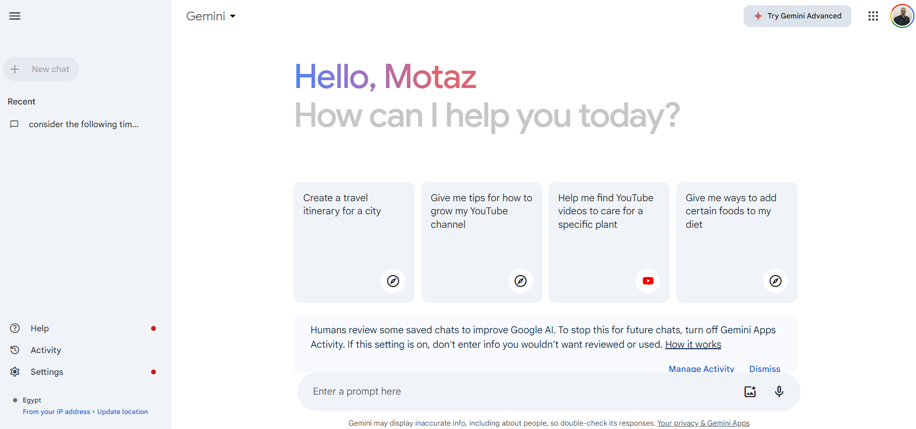
Gen AI Tools for end users (Gemini Web App)

Slide 16
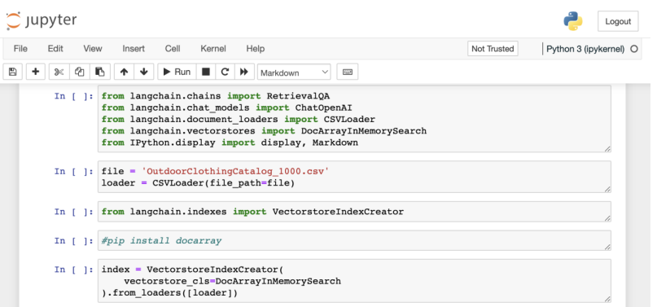
Generative AI is also a developer tool

Slide 17
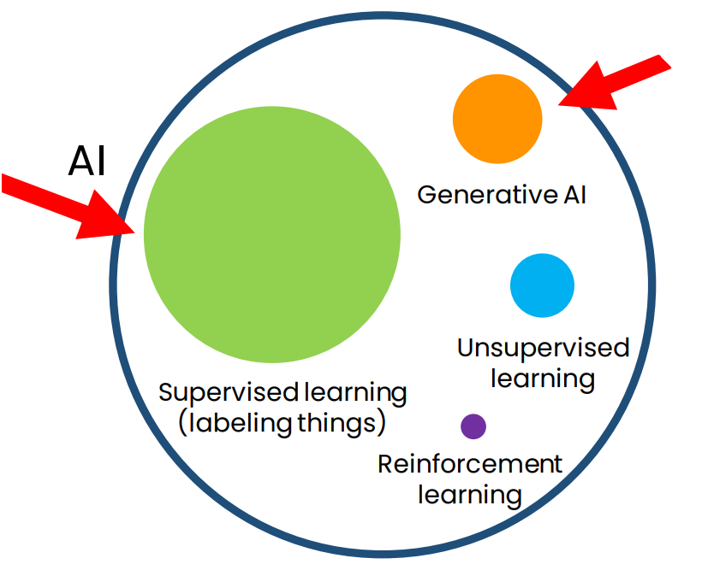
How generative AI works
AI is a set of tools

Slide 18
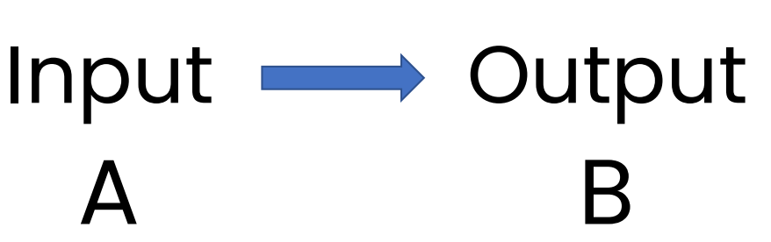
Supervised learning (labeling things)

Slide 19
Supervised learning (labeling things)
Input (A) ) | Output (B | Application
Email | Spam? (0/1) | Spam filtering
Ad, user info | Click? (0/1) | Online advertising
X-ray image | Diagnosis | Health-care
Image of phone | Defect? (0/1) | Visual inspection
Audio recording | Text transcript | Speech recognition
Restaurant reviews | Sentiment (+/-) | Reputation monitoring

Slide 20
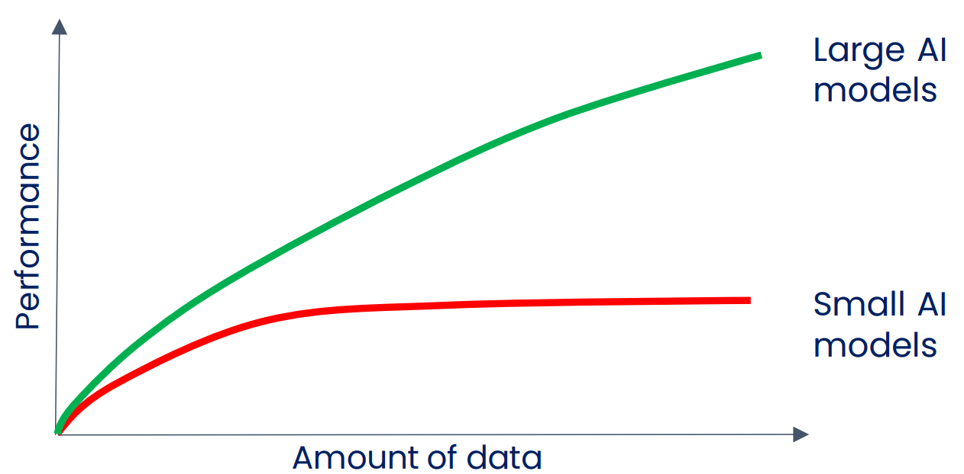
2010-2020: Large scale supervised learning

Slide 21
Large Language Models (LLMs)

Slide 22
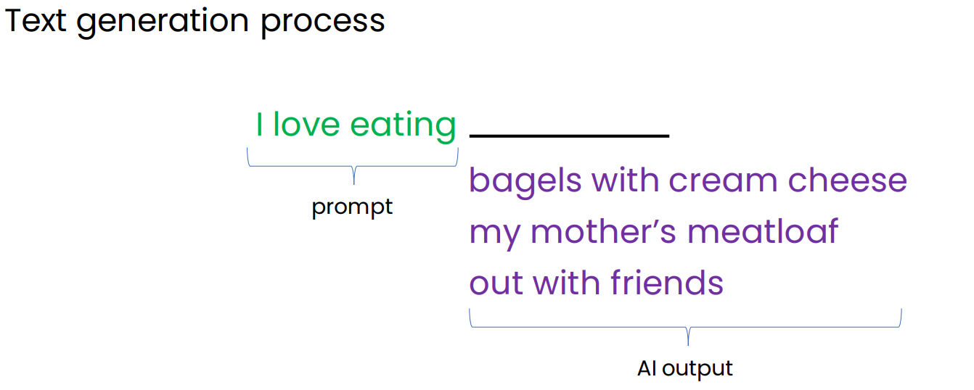
Generating text using Base LLM

Slide 23
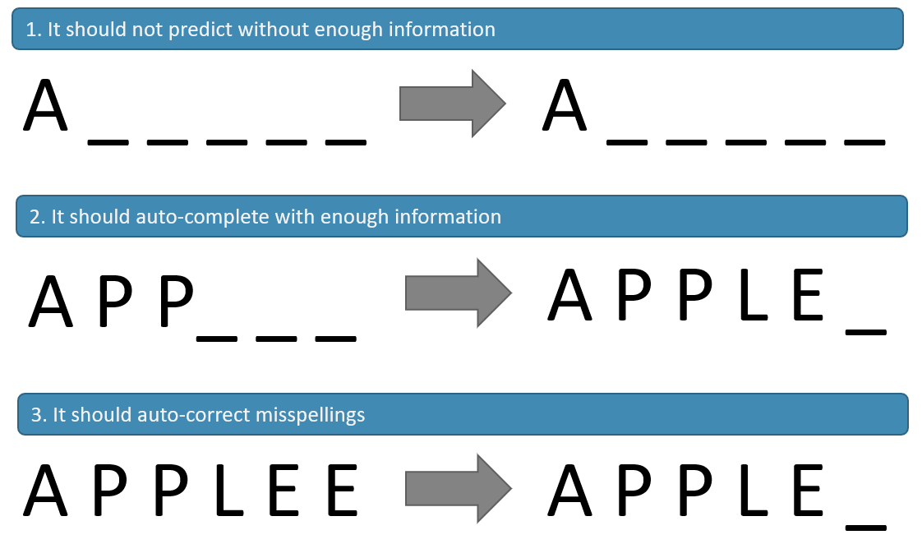
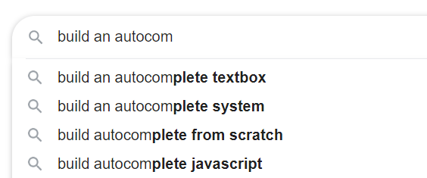
The Language Model

Slide 24
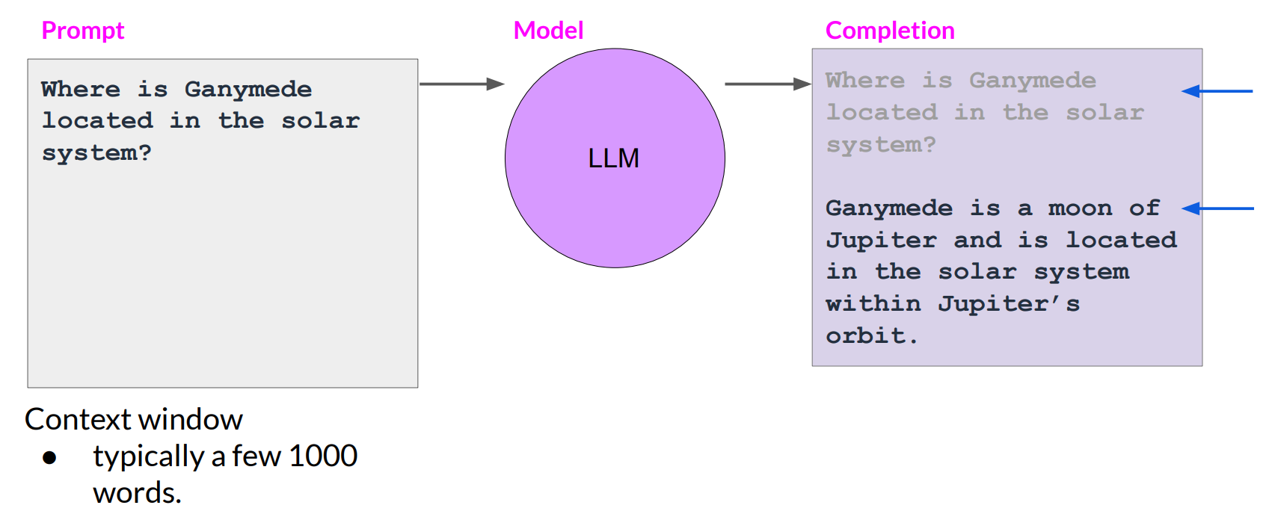
Prompts and completions

Slide 25



How LLMs work?
how to predict the next word?
learn from a huge text data such as books, Wikipedia, news articles, papers, magazines, ... etc.

Slide 26
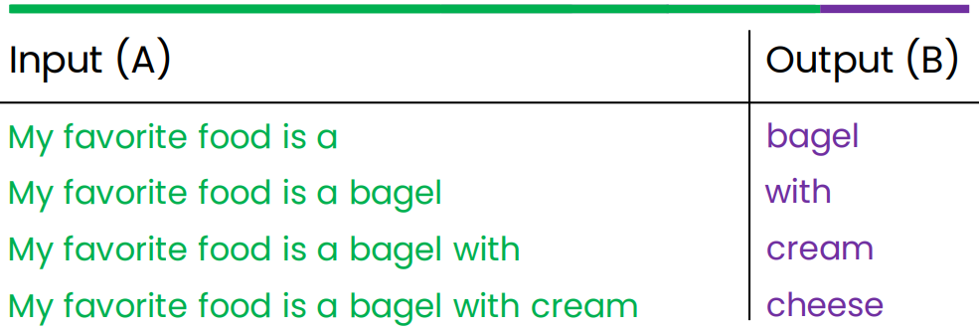
How LLMs work?
LLMs are built by using supervised learning (A→B) to repeatedly predict the next word.
My favorite food is a bagel with cream cheese
When we train a very large AI system on a lot of data (hundreds of billions of words), we get a Large Language Model like ChatGPT.

Slide 27
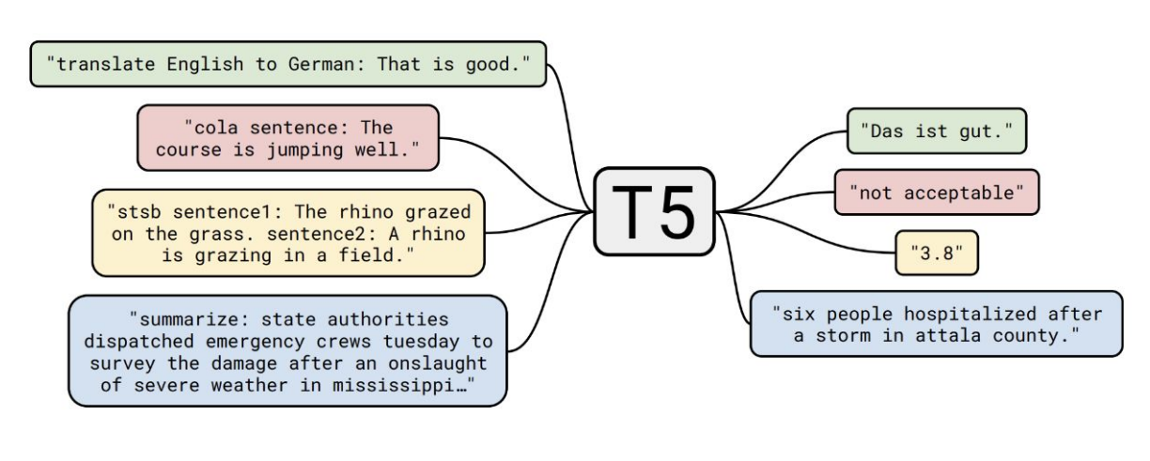
T5 LLM model used for several tasks

Slide 28
Types of LLMs
LLMs
Base LLM
Instruct LLM

Slide 29
Types of LLMs
Base LLM
Instruct LLM
Predicts the next word based on text training data.
Questions posed to Base LLM (no answers provided):
follow instructions but doesn’t always provide accurate answers.
Fine-tuned on instructions and good attempts at following them.
LLMs Reinforcement Learning with Human Feedback (RLHF)
Quality is measured via 3 measures
Helpful, Honest, Harmless: HHH
“Once upon a time, there was a unicorn that lived in a magical forest with all her unicorn friends.”
“What is the capital of France?
What is France’s largest city?
What is the currency of France?”
“What is the capital of France?
The capital of France is Paris.”

Slide 30
Helpful, Honest, Harmless: HHH
Helpful: Refers to the model’s ability to provide useful and relevant information or assistance.
Honest: Indicates that the model’s responses are truthful and transparent. When the model provides an answer, it aims to be honest rather than misleading or deceptive.
Harmless: Implies that the model’s outputs are not harmful or malicious. It won’t intentionally cause harm or negative consequences through its responses

Slide 31
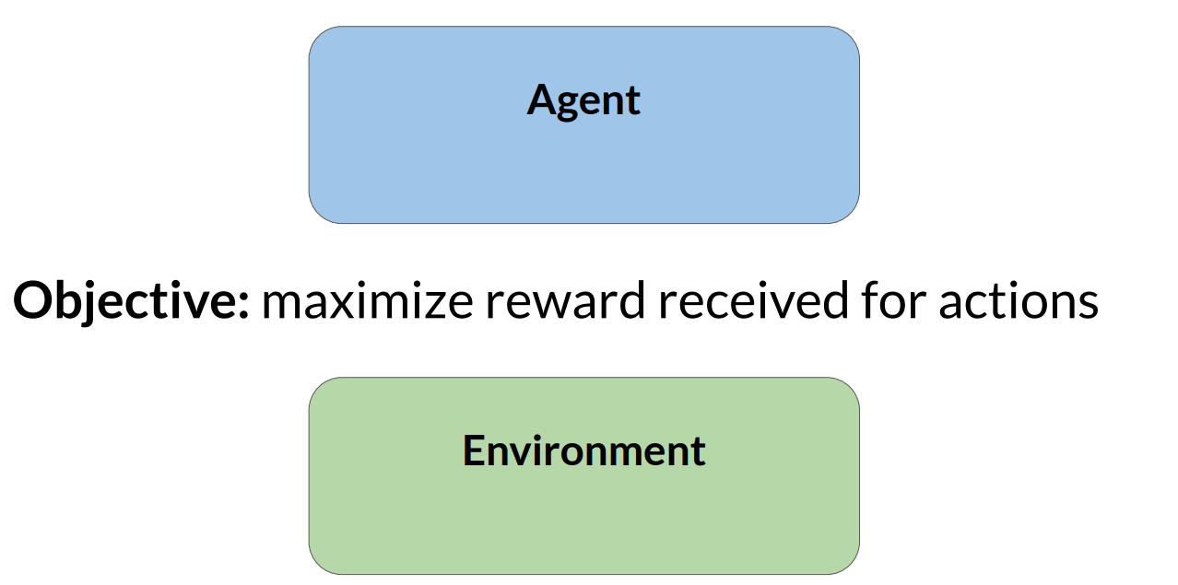
Reinforcement learning (RL)

Slide 32
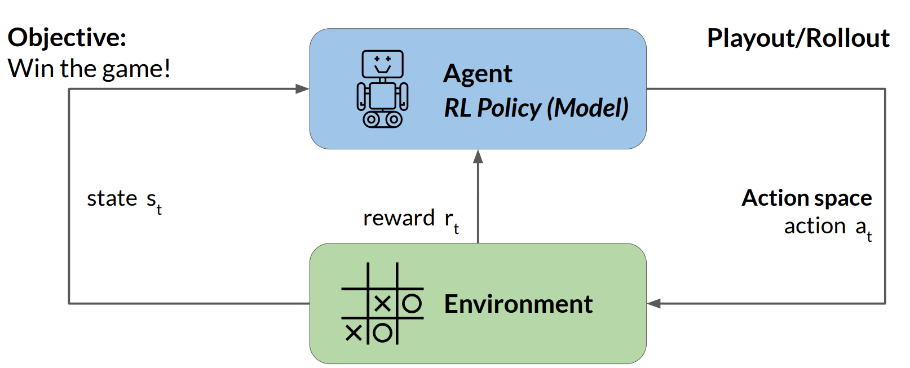
Reinforcement learning: Tic-Tac-Toe

Slide 33
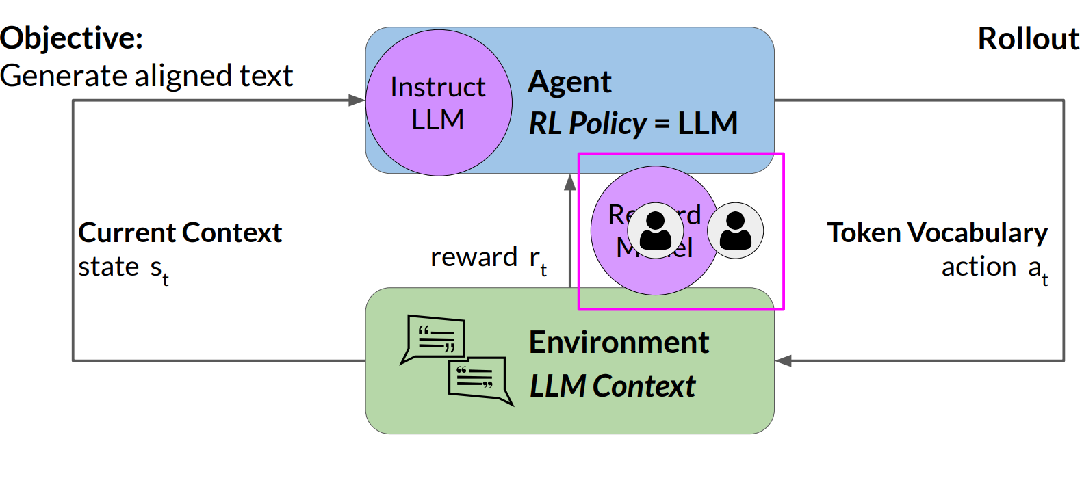
Reinforcement learning: fine-tune LLMs

Slide 34
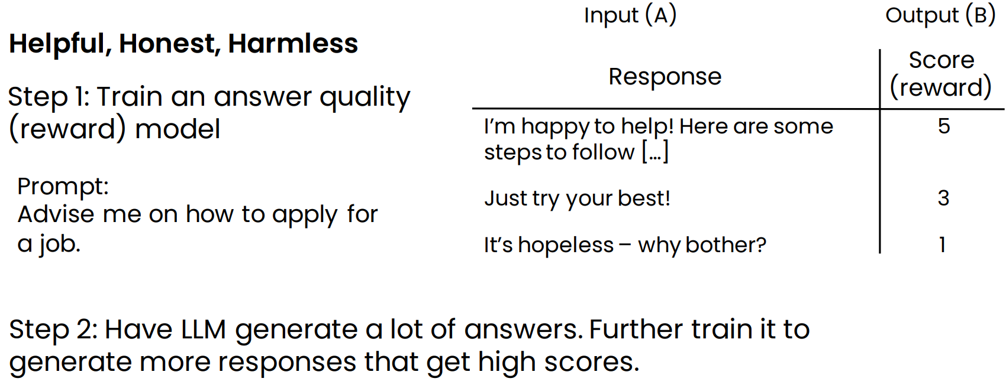
How do chat systems learn to follow instructions?
Reinforcement learning from human feedback (RLHF)

Slide 35
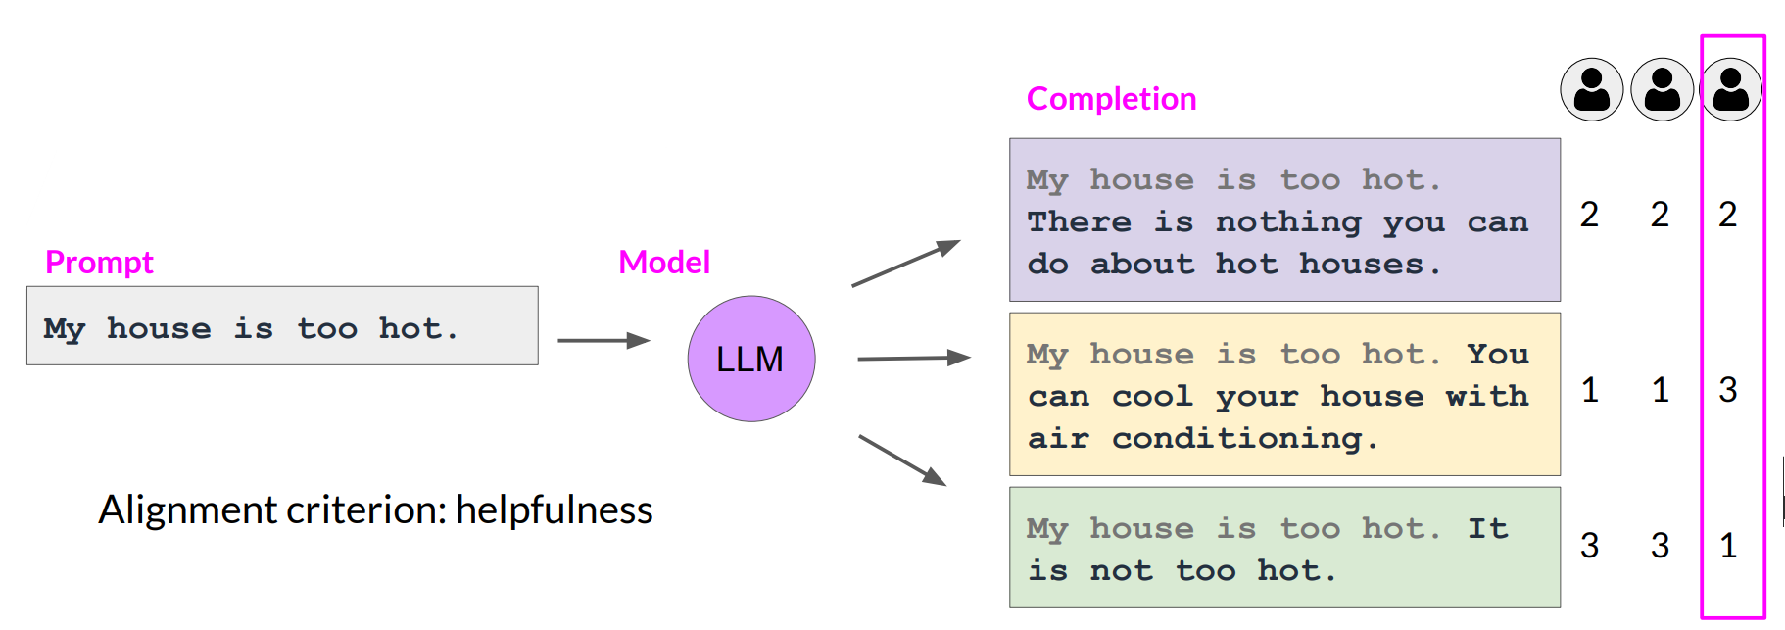
Collect human feedback
Define your model alignment criterion
For the prompt-response sets that you just generated, obtain human feedback through labeler workforce

Slide 36
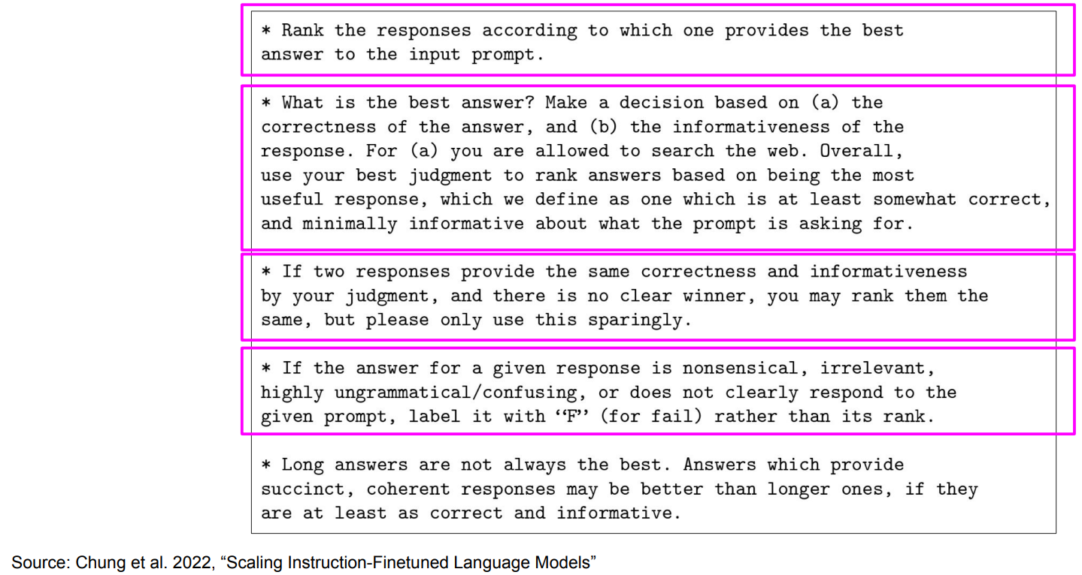
Sample instructions for human labelers

Slide 37
LLM size

Slide 38
Model size
# of Tokens:
The more text you feed a language model to train on, the better it is at providing human-like outputs across a large variety of domains.
# of Parameters:
The more parameters a model has, the larger its capacity to capture intricate nuances of language.

Slide 39
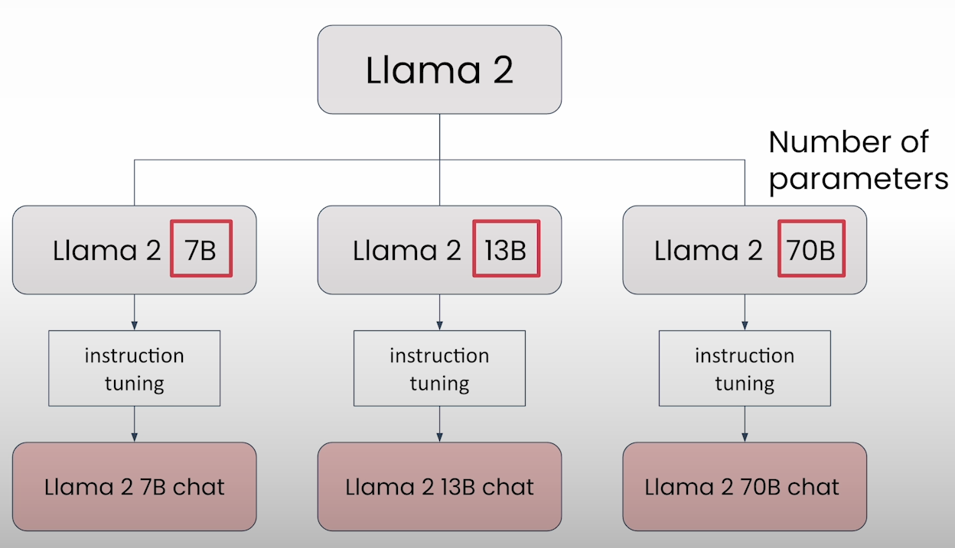
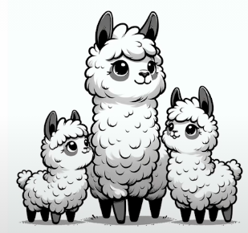
LLM Size (Llama 2)
Model size is identified by the number of parameters

Slide 40
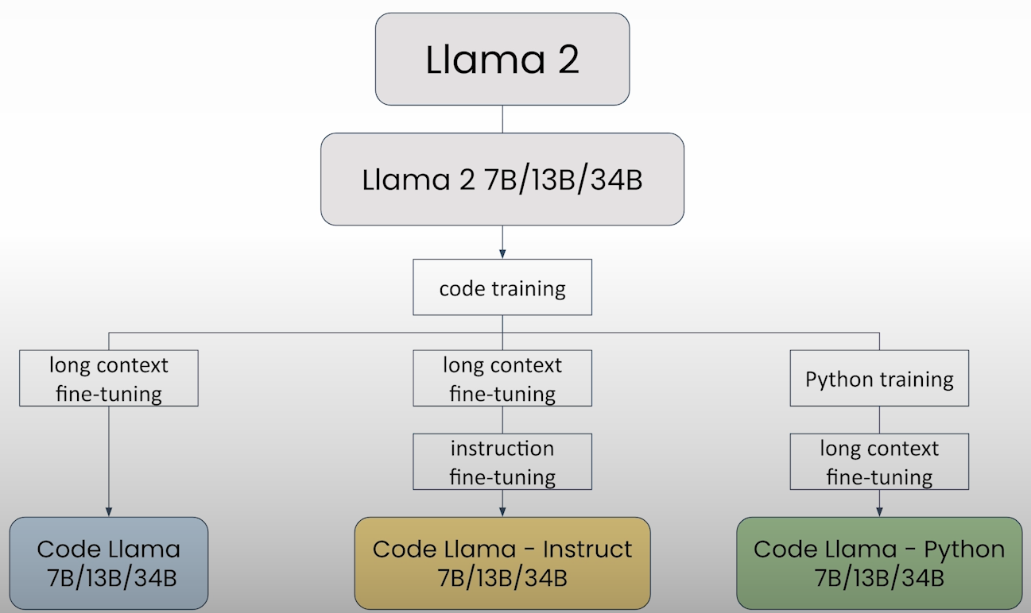
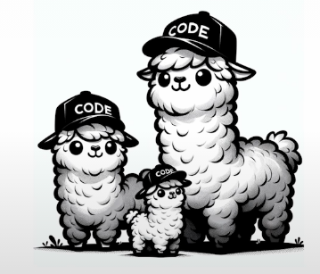
LLM Size (Code Llama 2)

Slide 41
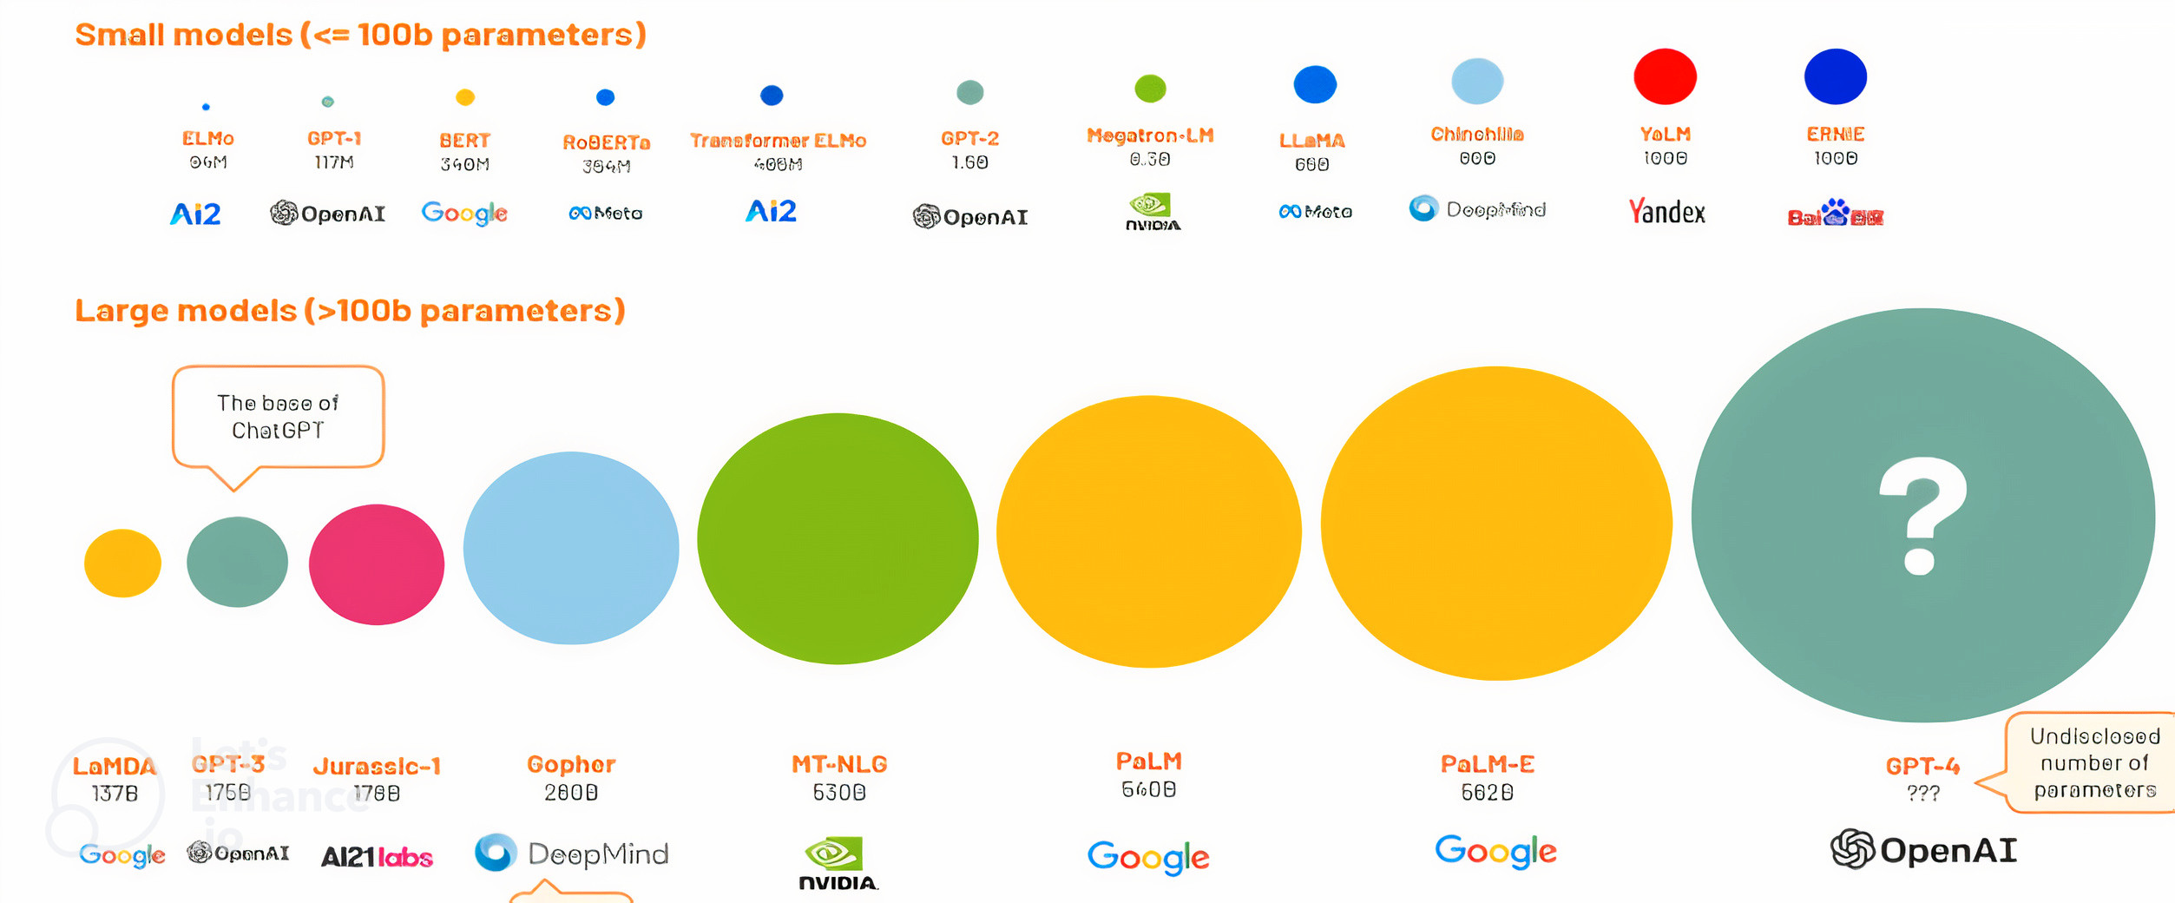
model size (# of parameters)
LLMs becoming small!!

Slide 42
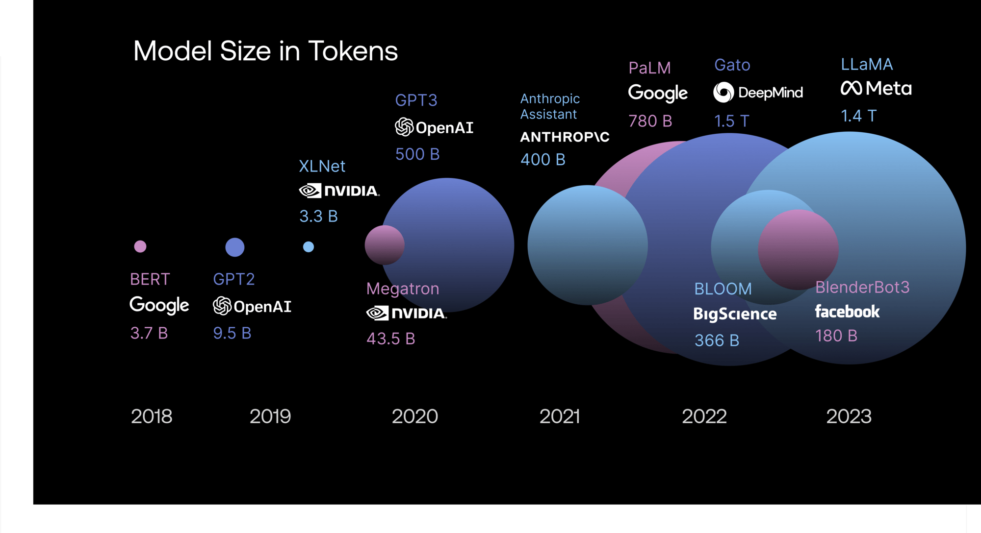
model size (# of tokens)

Slide 43
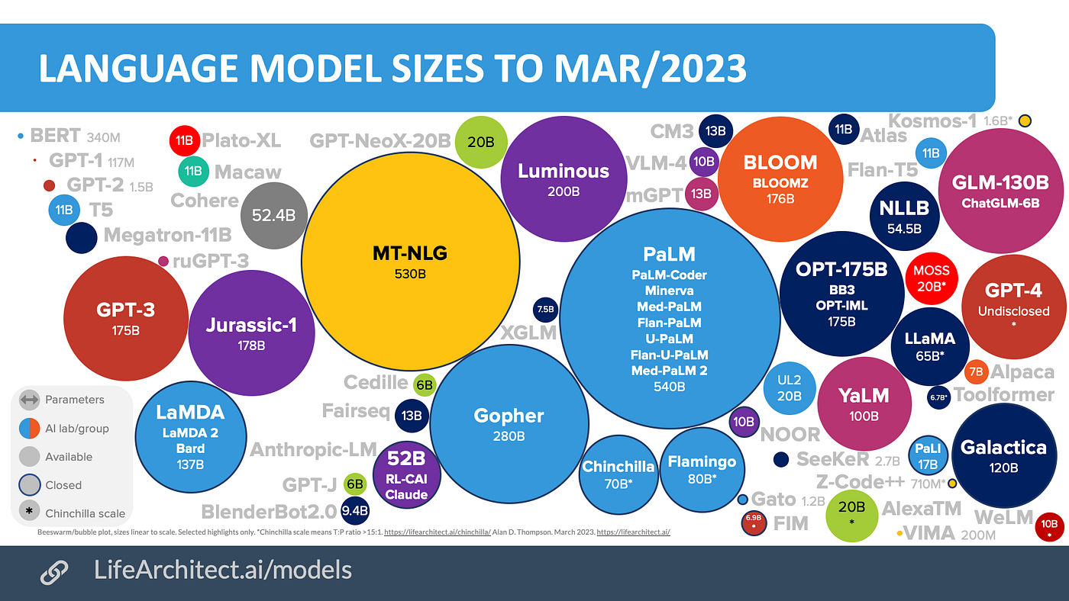

Slide 44
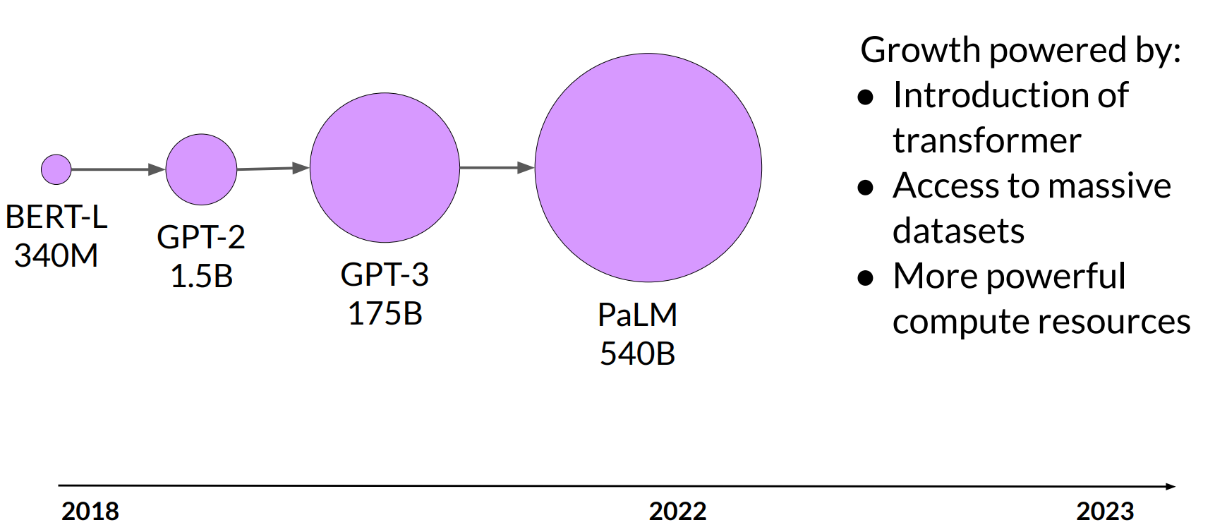
Model size vs. time

Slide 45
Model size
Parameters
~1B | Pattern matching and basic knowledge of the world.
~10B | Greater world knowledge. Can follow basic instructions
~100B+ | Rich world knowledge. Complex reasoning

Slide 46
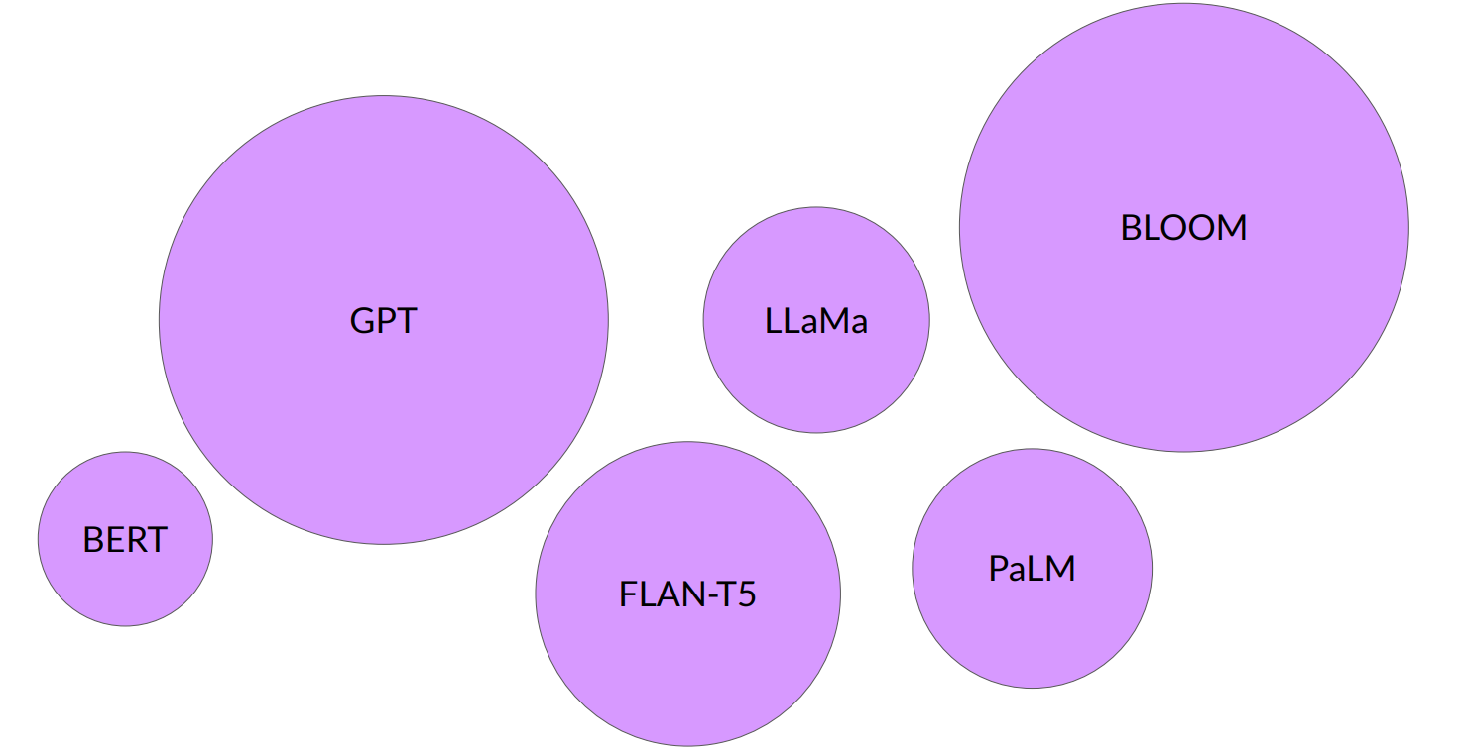
Large Language Models

Slide 47

The significance of scale: language understanding

Slide 48
Closed or open source?
Closed-source
Open-source
Easy to use in applications
More large/powerful models
Relatively inexpensive
Some risk of vendor lock-in
Full control over model
Can run on your own device (on-prem, PC, etc.)
Full control over data privacy/access

Slide 49
How to use LLM? What is Possible?!

Slide 50
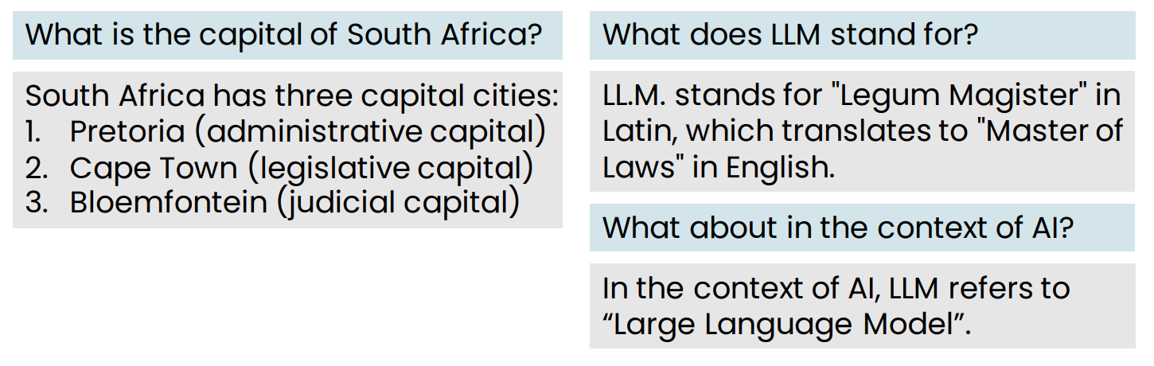
LLMs as a thought partner
LLMs is a new way to find information

Slide 51
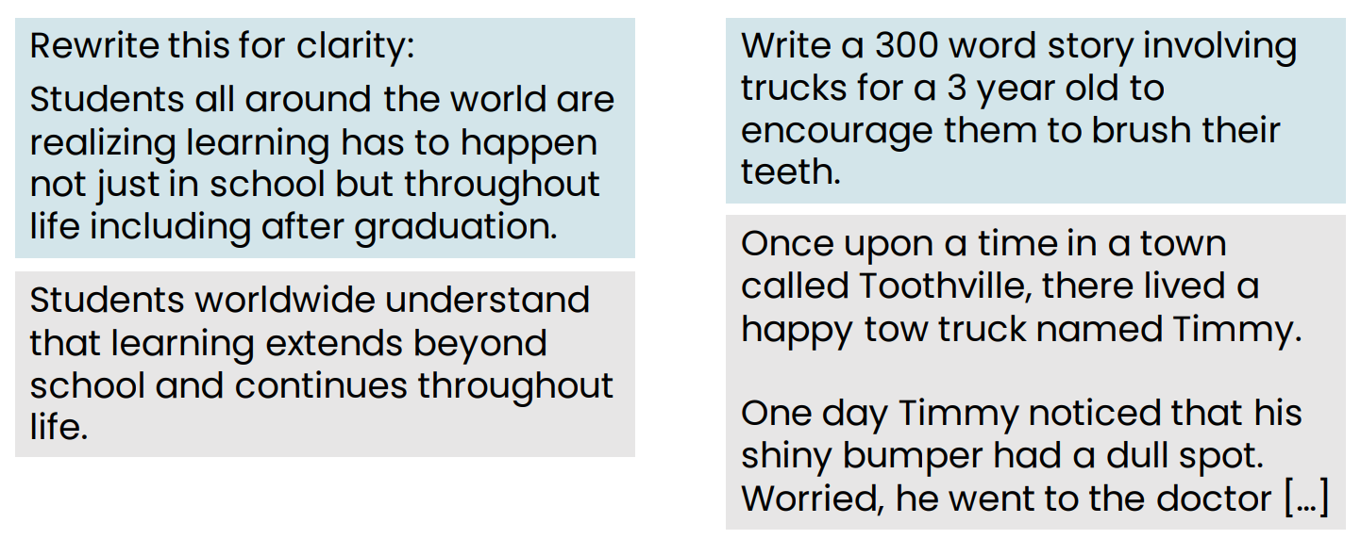
Writing partner

Slide 52
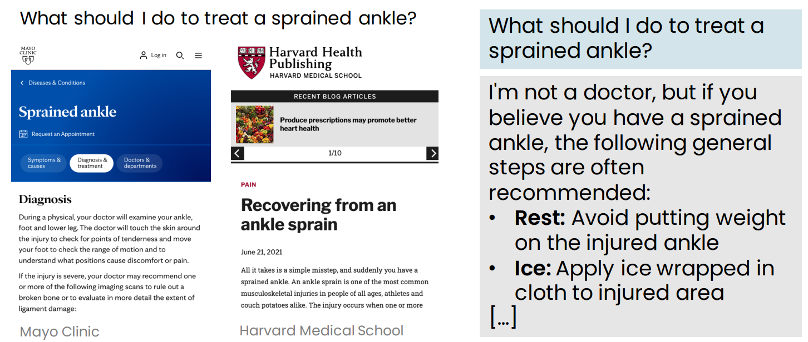
Web search or using an LLM?

Slide 53
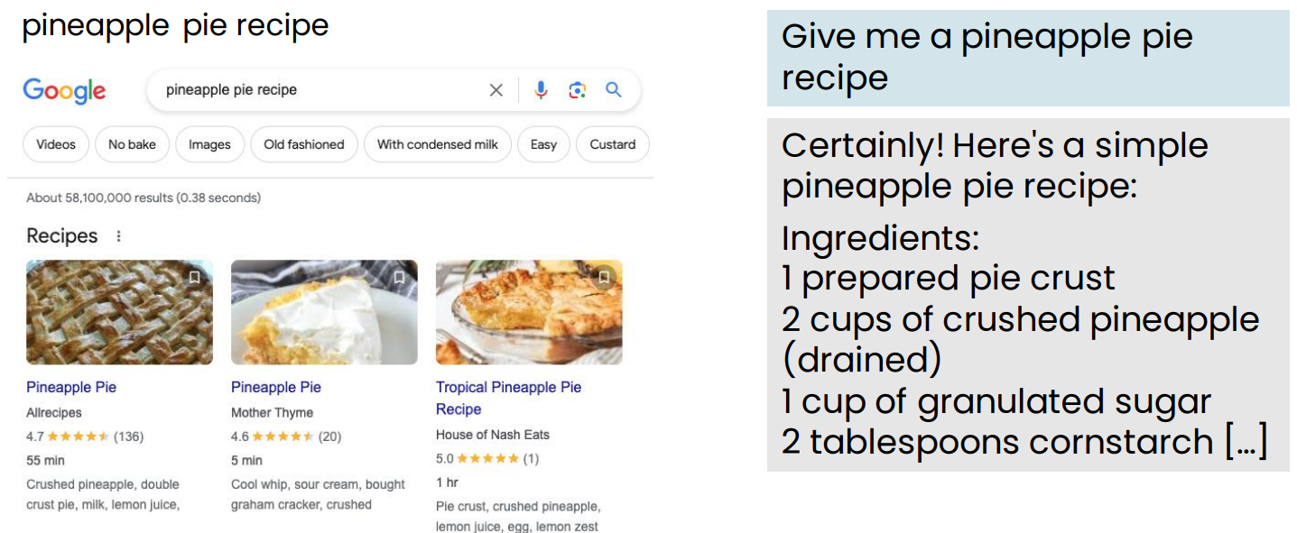
Web search or using an LLM?

Slide 54
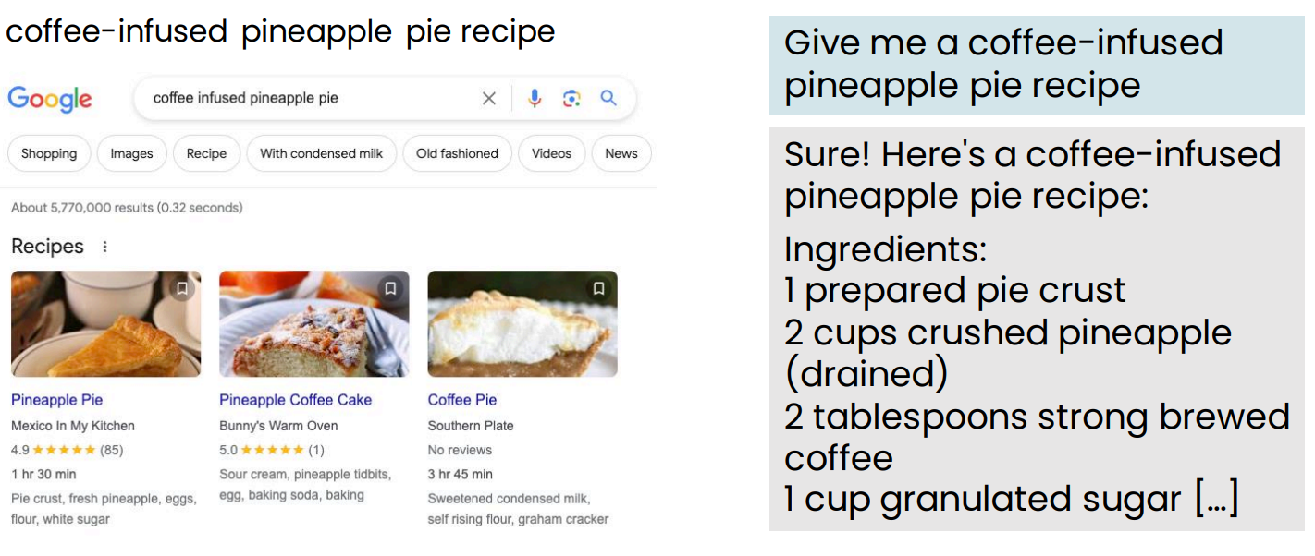
Web search or using an LLM?

Slide 55
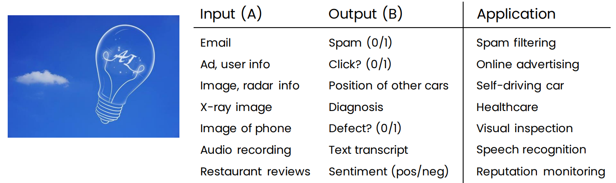
AI is a general purpose technology
Similar to electricity, AI is useful for many tasks

Slide 56
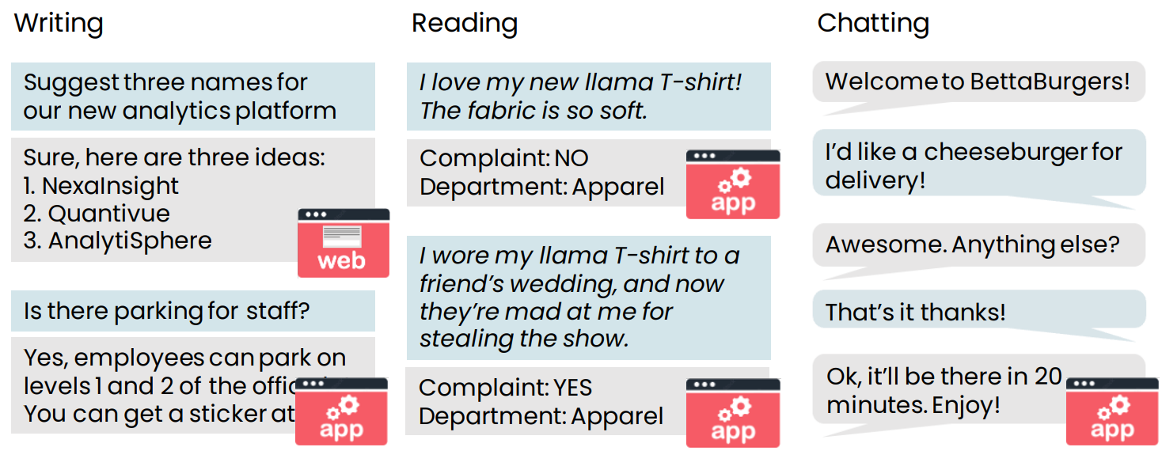
Examples of tasks LLMs can carry out

Slide 57
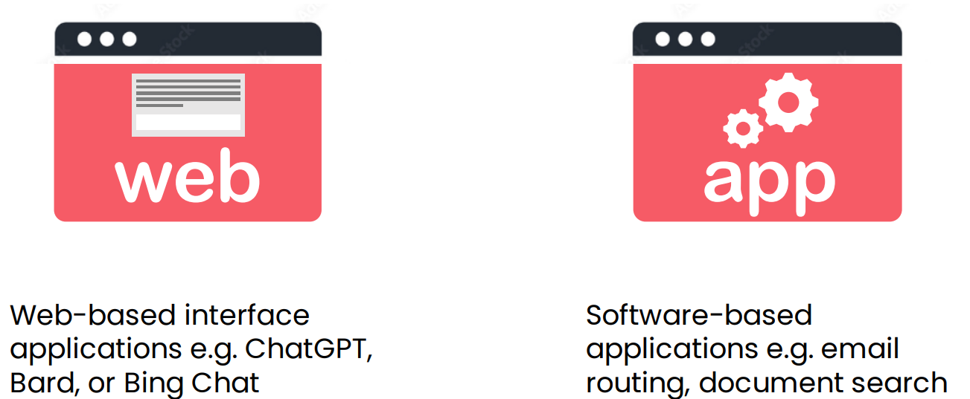
Web-based vs. software application use of LLMs

Slide 58
Brainstorming product names
Brainstorm 5 creative names for peanut butter cookies
Sure thing! Here are some ideas:
1. Nutty Nirvana Nibbles
2. ButterBite Bliss
3. Peanut Paddle Pucks
4. ButterNutter Crunchies
5. Nutty Nom-Nom Nuggets

Slide 59
Developing sales strategy
Brainstorm five ideas for increasing cookie sales in Q4
1. Limited-time only seasonal flavors.
2. Beautifully packaged gift sets.
3. Buy more, save more deals.
4. Interactive holiday displays
5. Recipe cards

Slide 60
Writing a press release
Write a press release announcing the hire of a new COO
[Company Name] Welcomes [New COO’s Full Name] as
Chief Operations Officer
[City, State, Date] – [Company Name], a leading [brief
description of the company’s industry or niche], is thrilled
to announce [New COO’s Full Name] as its new Chief
Operations Officer (COO). [New COO’s first name] brings a
wealth of experience […]

Slide 61
Writing a press release – improved prompt
Write a press release announcing the hire of our new COO using the following information:
COO bio: Nadiya Grenner received her MBA from Cornell…
Company info: General Robotics, headquartered in Boston, MA, is a leader in robotics research and manufacturing…
General Robotics Welcomes Nadiya Grenner as Chief
Operations Officer Boston, MA – General Robotics, a leading robotics research and manufacturing company, is thrilled to announce
Nadiya Grenner as its new COO. A graduate of Cornell’s […]

Slide 62
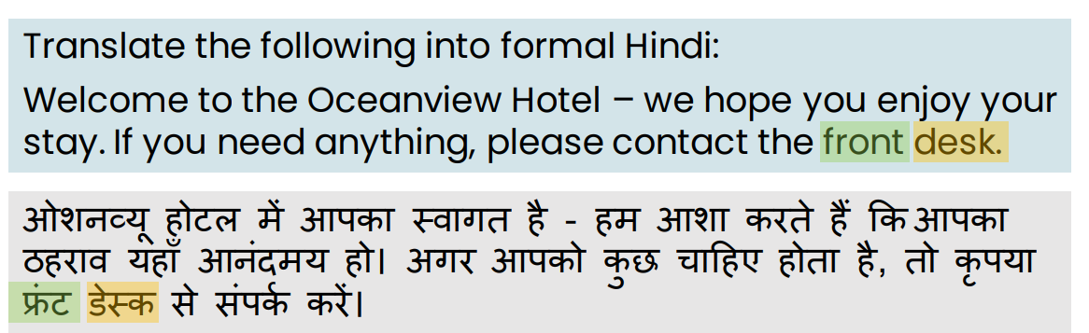
Translation

Slide 63
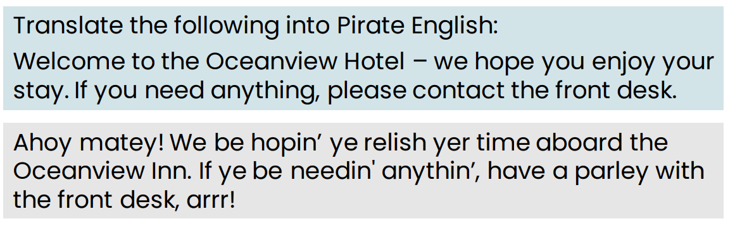
Translation: Pirate English
Notes:
Arr, matey! Pirate English be the language spoken by swashbucklin' pirates on the high seas. It's a whimsical and playful way of talkin', full of colorful phrases, nautical terms, and hearty "Arrrrs!" If ye want to sound like a true buccaneer, give it a try! 🏴‍☠️⚓
If ye be lookin' to translate words into Pirate Speak, ye can use this [Pirate Speak Translator](https://lingojam.com/PirateSpeak). Fair winds and follow the stars, me heartie! 🌊🗺️
Source: Conversation with Copilot, 7/14/2024
(1) Pirate Speak Translator ― LingoJam. https://lingojam.com/PirateSpeak.
(2) PIRATE definition and meaning | Collins English Dictionary. https://www.collinsdictionary.com/dictionary/english/pirate.
(3) pirate noun - Definition, pictures, pronunciation and usage notes .... https://www.oxfordlearnersdictionaries.com/definition/english/pirate_1.
(4) PIRATE | definition in the Cambridge English Dictionary. https://dictionary.cambridge.org/us/dictionary/english/pirate.
(5) Pirate Monkeyness Insults and Translations. https://pirate.monkeyness.com/translate.

Slide 64
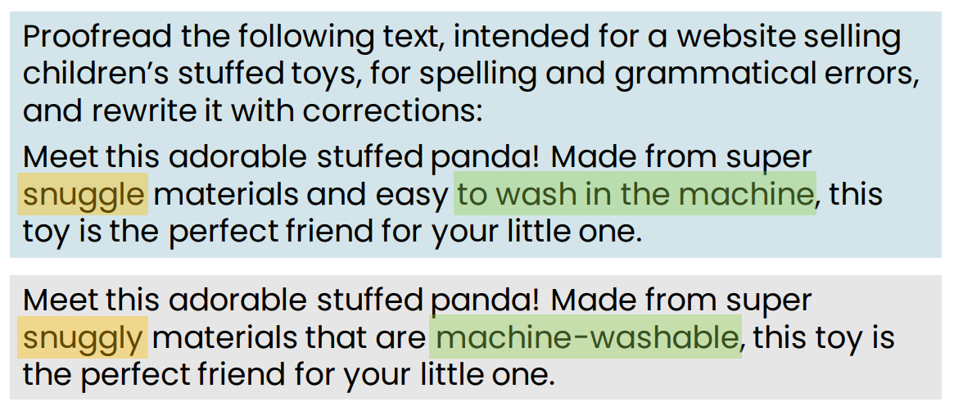
Proofreading

Slide 65
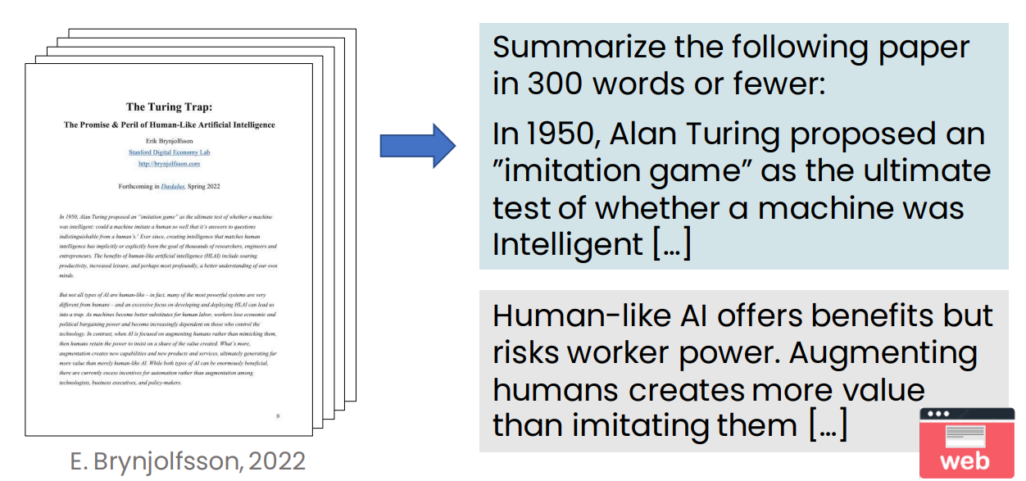
Summarizing an article

Slide 66
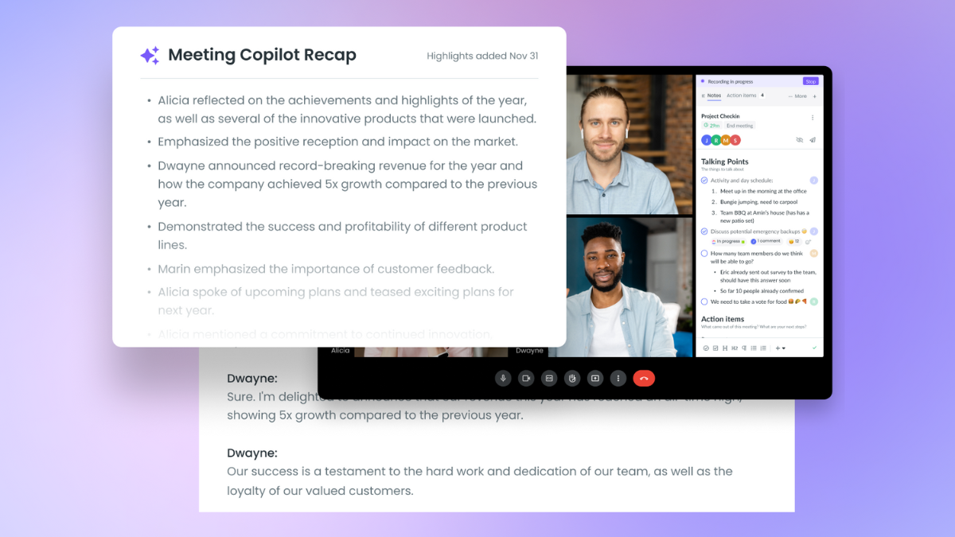
Meeting Copliot recap in MS Teams

Slide 67
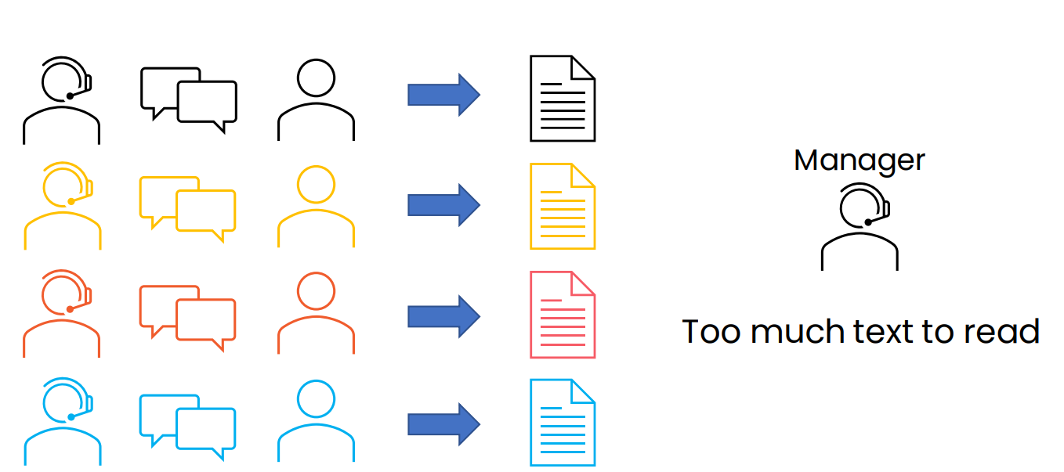
Summarizing call center conversations

Slide 68
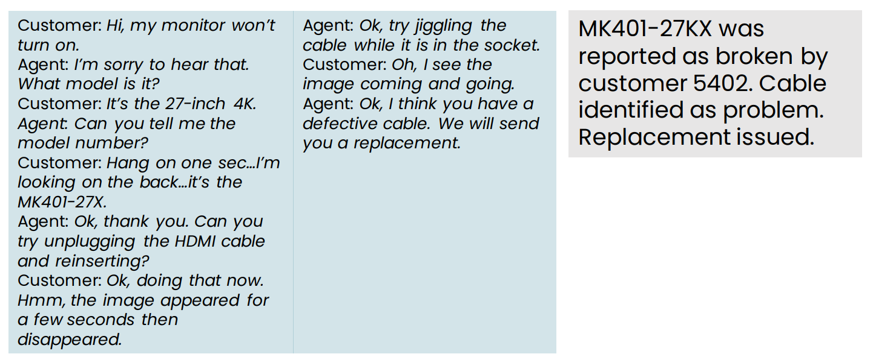
Summarizing conversations

Slide 69
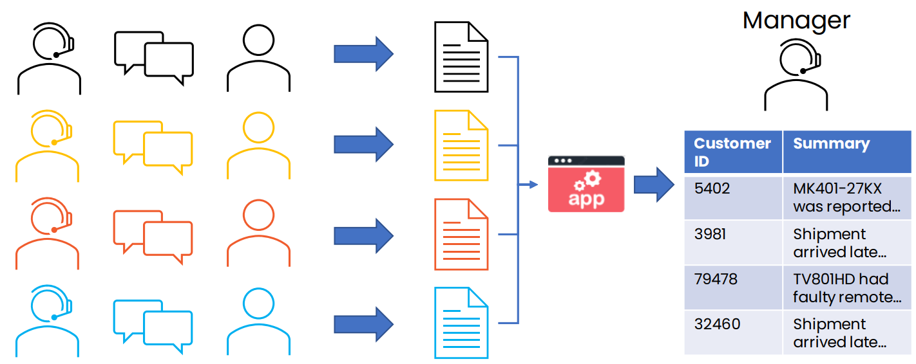
Summarizing call center conversations

Slide 70

Customer email analysis

Slide 71

Detailed look at email routing prompt

Slide 72

Dashboard to track customer sentiment over time

Slide 73

Specialized Chatbots

Slide 74

The rise of chatbots in customer service

Slide 75

Summary of Examples of tasks LLMs can carry out

Slide 76

LLM use cases & tasks

Slide 77
LLM as reasoning engine
LLMs have a lot of general knowledge, but they don’t know everything
By providing relevant context in the prompt, we ask an LLM to read a piece of text, then process it to get an answer
We’re using it as a reasoning engine to process information, rather than using it as a source of information

Slide 78
What LLMs can and cannot do

Slide 79


What LLMs can and cannot do
What prompting an LLM can do
Can a fresh college graduate follow the instructions to complete the task?
Determine if an email is a complaint?
Determine if a review is positive or negative?

Slide 80
What LLMs are Good vs Bad at
LLMs are good at
LLMs are bad at
Language translation
Content summarization
Content generation
Writing support
Question answering
Correcting spelling and grammar
Programming support
Classification (spam detection)
Simplifying complex content
Stylized writing
Sentiment analysis
Current events
Common sense
Math/counting
Handling uncommon scenarios
Consistency
High-level strategy
Being factual 100% of the time
Reasoning & logic
Emotional intelligence
Representing minorities
Extended recall/memory

Slide 81

Knowledge cut-offs in LLMs

Slide 82

Knowledge cutoffs
An LLM’s knowledge of the world is frozen at the time of its training
A model trained on data scraped from internet in January 2022 has no information about more recent events

Slide 83

Knowledge cutoffs
Claims of room temperature superconductor LK-99

Slide 84

Making things up: Hallucinations

Slide 85

Making things up: Hallucinations

Slide 86

Tools for reasoning
LLM in general are bad in calculations, that is why agents are used to help.

Slide 87

Agents
Use LLM to choose and carry out complex sequences of actions
Cutting edge area of AI research

Slide 88

The input (and output) length is limited
Many LLMs can accept a prompt of up to only a few thousand words.
The total amount of context you can give it is limited

Slide 89
The input (and output) length is limited
Many LLMs can accept a prompt of up to only a few thousand words.
The total amount of context you can give it is limited
Some LLMs have longer context limits – up to 100,000 words
An LLM’s context length is the limit on the total input+output size

Slide 90


Q&A

